Slide 1
Chapter Six
List, tuple, named tuple, list of lists, list comprehension

Slide 2
Basic Properties of Lists

Slide 3
Lists
A list is a container data type: it can contain multiple data values. The data are stored in a linear sequence and in a particular order.
In Python a list is also considered an iterable, which is a container where data is in a sequence and can be iterated over (we can walk through all data values).
So far we’ve seen with 2 data types that are containers and iterables: a list and a string.
A list can contain different data types: int, float, str, and even another list.
The smallest size list is an empty list, or a list with no data.
A list can grow to accommodate new data that are added to it, or it can shrink if data is removed from it.

Slide 4
Lists vs. Strings
Both lists and strings are iterables and the [ ] operator is used to access an element in both sequences.
There are two differences between lists and strings:
Lists are sequences of any data types, whereas strings are sequences of characters.
Moreover:
strings are immutable— we cannot change the characters in a string.
Lists are mutable – we can change the data in a list.

Slide 5
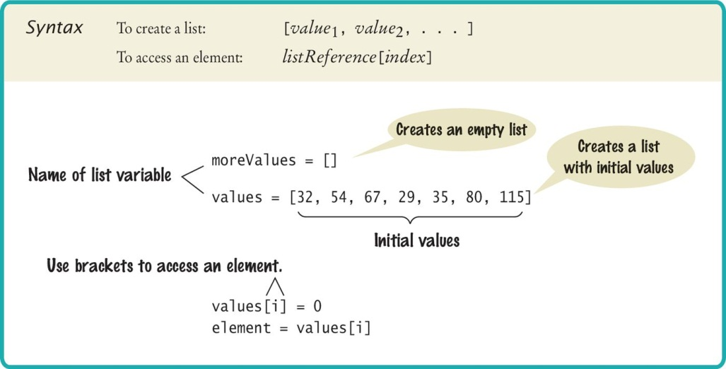
Creating a List
Specify a list variable with the subscript operator []

Slide 6
Accessing List Elements
A list is a sequence of elements, each of which has an integer position or index.
To access a list element, we specify the corresponding index (location of the data) that we want.
To specify an index, we use the subscript operator [ ] in the same way that we access individual characters in a string.
When the [ ] immediately follow a variable name, they are used as the subscript operator:
When the [ ] follow an “=“ they create a new list:
print(values[5])
values = [4]
values[5] = 87

Slide 7
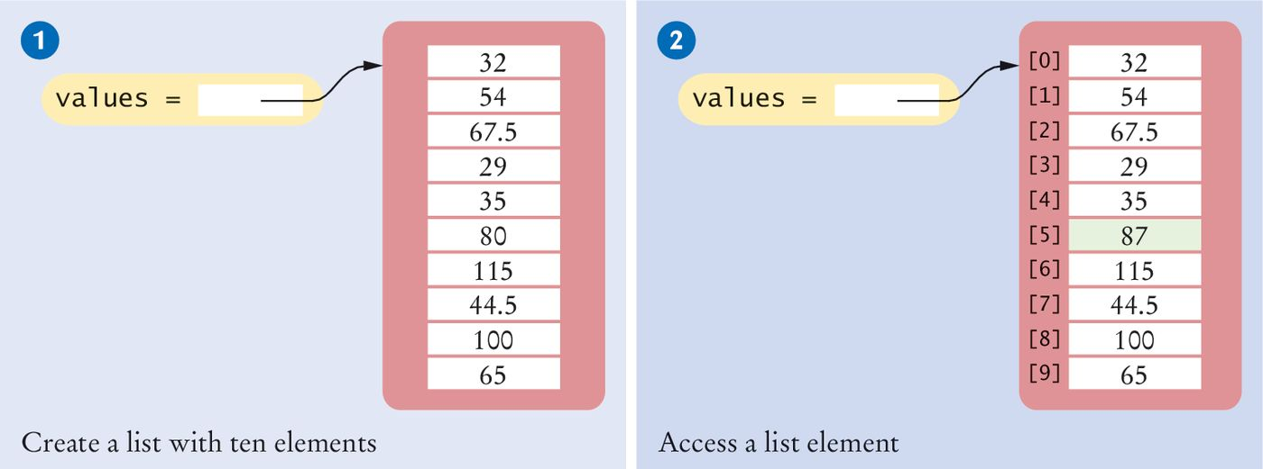
Creating Lists/Accessing Elements
# 1: Creating a list
values = [32, 54, 67.5, 29, 35, 80, 115, 44.5, 100, 65]
# 2: Accessing a list element
values[5] = 87

Slide 8
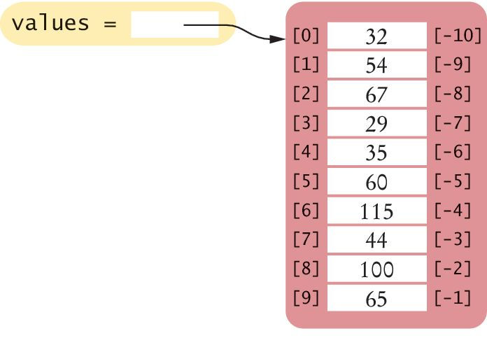
Reverse Subscripts
Python also uses negative subscripts to provide access to the list elements in reverse order.
For example, a subscript of –1 provides access to the last element in the list:
Similarly, values[-2] is the second-to-last element.
last = values[-1]
print("The last element is", last)
# output: The last element is 65

Slide 9
Out of Range Errors
Perhaps the most common error in using lists is accessing a nonexistent element:
If our program accesses a list through an out-of-range index, the program will generate an exception at run time.
values = [2.3, 4.5, 7.2, 1.0, 12.2, 9.0, 15.2, 0.5]
values[8] = 5.4
# Error––values has 8 elements,
# so the index range is from 0 to 7
values[-12] = 5.4 # Same out of range error

Slide 10

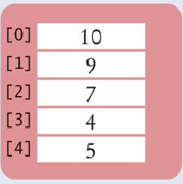
List References
There is a big difference between the:
List variable: The named reference or pointer to the list
List contents: Memory where the values are stored
scores = [10, 9, 7, 4, 5]
List variable
List contents
Reference
Reference
Values

Slide 11
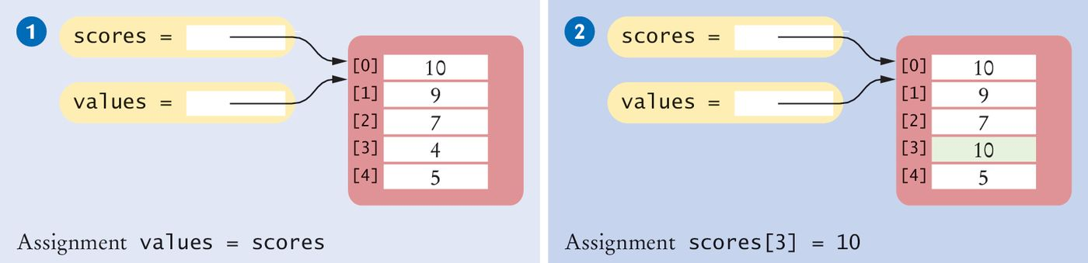
List Aliases
When we assign a list name to another variable name, both names refer to the same list.
The second variable is an alias for the first because both variables reference the same list. They are different names of the same list.
scores = [10, 9, 7, 4, 5]
values = scores # Copying list reference
List contents
References

Slide 12
Modifying Aliased Lists
Because both scores and values point to the same list in memory, we can modify the list through either of the variables:
This concept is important when a list is passed to a function. The called function gets an alias of the original list and can modify the list.
scores[3] = 10
print(values[3]) # Prints 10

Slide 13
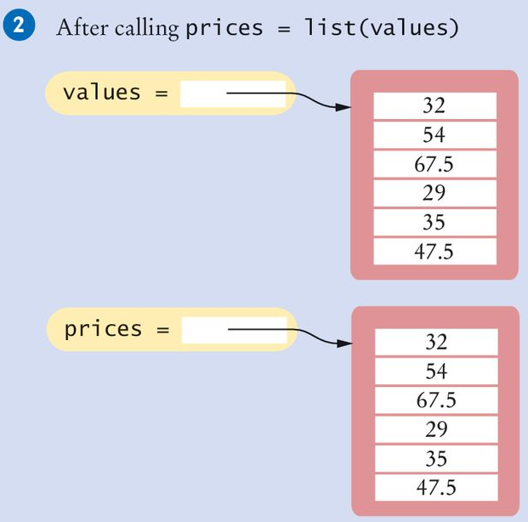
Copying Lists
Instead of creating an alias to a list, we can actually make another copy of a list.
Copying a list results in a duplicate list: a new list that has the same elements in the same order.
To copy a list made of numbers or strings, we can use the list() function:
The list() function is used to create a new list from any iterable.
prices = list(values)

Slide 14
List Operators

Slide 15
Concatenation
The concatenation of two lists is a new list that contains the elements of the first list, followed by the elements of the second.
myFriends = ["Fritz", "Cindy"]
yourFriends = ["Lee", "Pat", "Phuong"]
Two lists can be concatenated by using the plus (+) operator:
ourFriends = myFriends + yourFriends
# Sets ourFriends to ["Fritz", "Cindy", "Lee", "Pat","Phuong"]
Just like with numbers, the + operator doesn’t modify the two lists that are the operands.

Slide 16
Replication
The replication of two lists is a new list that contains the elements of the first list, followed by the elements of the second
monthInQuarter = [1, 2, 3] * 4
Results in monthInQuarter: [1, 2, 3, 1, 2, 3, 1, 2, 3, 1, 2 ,3]
We can place the integer on either side of the “*” operator
The integer specifies how many copies of the list should be concatenated
One common use of replication is to initialize a list with a fixed value:
monthlyScores = [0] * 12

Slide 17
Equality / Inequality Testing
We use the == operator to compare whether two lists have the same content: same elements, in the same order.
We use the is operator to compare whether two references point to the same list.
L1 = [1, 4, 9]
L2 = L1
L1 is L2 # True
L1 == L2 # True
L3 = [1, 4, 9]
L1 is L3 # False
L1 == L3 # True
The opposite of == is !=
[1, 4, 9] != [4, 9] # True

Slide 18
Built-in Functions for Lists

Slide 19
Determining List Length
We can use the len function to obtain the length of the list; that is, the number of elements:
numElements = len(values)

Slide 20
Sorting a List
We can use the sorted function to sort a list
The sorted function returns the sorted list. The original list is unchanged.
The default sort is ascending order.
To sort in reverse order, set the reverse keyword argument to True
myList = [10, 2, 9, 6, 4, 5]
newList = sorted(myList)
print(newList) # output: [2, 4, 5, 6, 9, 10]
myList = [10, 2, 9, 6, 4, 5]
newList = sorted(myList, reverse=True)
print(newList) # output: [10, 9, 6, 5, 4, 2]

Slide 21
Sum, Maximum, Minimum
If we have a list of numbers, the sum function yields the sum of all values in the list.
sum([1, 4, 9, 16]) # Yields 30
For a list of numbers or strings, the max and min functions return the largest and smallest value:
max([1, 16, 9, 4]) # Yields 16
min("Fred", "Ann", "Sue") # Yields "Ann"

Slide 22
Working with Lists

Slide 23
Loop to Iterate Through a List (1)
Given the dataList that contains 10 elements, we will want to set a variable, say i, to 0, 1, 2, and so on, up to 9.
There are several ways of doing this.
Why is the second version better?
# First version (list index used)
for i in range(10) :
print(i, dataList[i])
# Better version (list index used)
for i in range(len(dataList)) :
print(i, dataList[i])

Slide 24
Loop to Iterate Through a List (2)
In this case the dataList is used directly with the for loop. With each iteration of the loop, one element of the list is stored in the variable element.
The third way is the most common way to loop through a list if we don’t need the index values.
The enumerate function returns a pair of values: a incrementing integer and the list element. The integer starts at 0, which serves as the index for the list element.
# Third version: index values not needed
for element in dataList :
print(element)
# Fourth version: index values not needed
for i,element in enumerate(values):
print(i, element)

Slide 25
Slices of a List (1)
Sometime we want only a part of a list or a slice from a list.
Suppose we have a list of temperatures:
We are only interested in the temperatures for the third quarter, with index values 6, 7, and 8. We can use the slice operator to obtain them:
The arguments are the first element to include, and the first to exclude
thirdQuarter is another list: [39, 36, 30]
temperatures = [18, 21, 24, 33, 39, 40, 39, 36, 30, 22]
thirdQuarter = temperatures[6:9]

Slide 26
Slices of a List (2)
Both indices of the slice operator are optional.
If the first index is omitted, the starting index is 0 :
If the last index is omitted, the ending index is the last one:
If both indices are omitted, then the entire list is returned:
We can assign values to a slice:
replaces the values in elements 6, 7, and 8 with 45, 44, 40
temperatures = [18, 21, 24, 33, 39, 40, 39, 36, 30, 22]
temperatures[:4] # returns [18,21,24,33]
temperatures = [18, 21, 24, 33, 39, 40, 39, 36, 30, 22]
temperatures[7:] # returns [36,30,22]
newTemp = temperatures[:] # newTemp is another copy of
# temperatures
temperatures[6:9] = [45,44,40]

Slide 27
List Methods

Slide 28
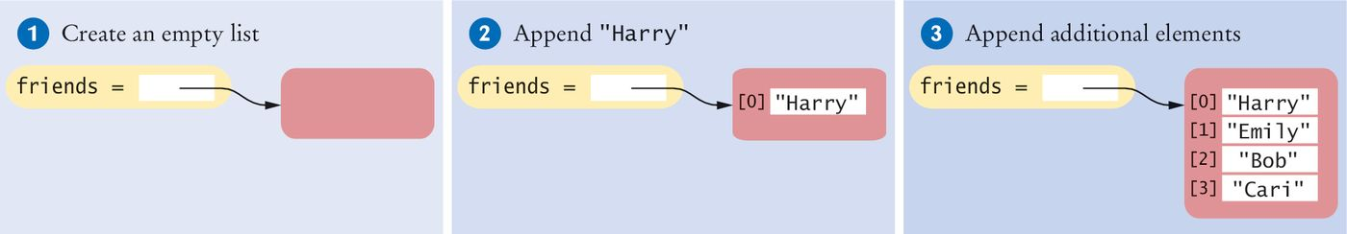
Appending an Element
Sometimes we may not know the values that will be contained in the list when it’s created
In this case, we can create an empty list and add elements to the end as needed
#1
friends = []
#2
friends.append("Harry")
#3
friends.append("Emily")
friends.append("Bob")
friends.append("Cari")

Slide 29
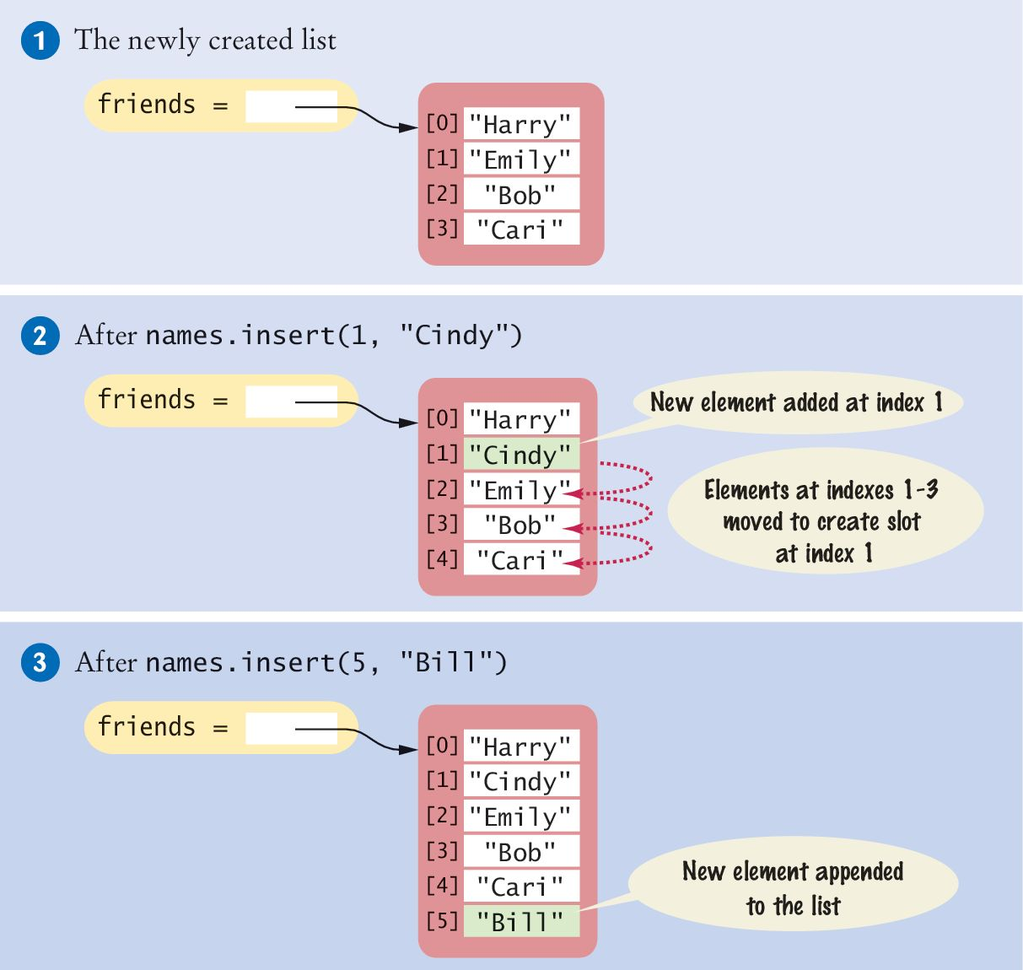
Inserting an Element
Sometime we want to add an element in the middle of a list instead of appending it to the end of the list.
A new element has to be inserted at a specific position in the list
#1
friends = ["Harry", "Emily", "Bob", "Cari"]
#2
friends.insert(1, "Cindy")

Slide 30
Extending a List
If we want to append one list to another list, we can extend the list:
list1 = [1, 2, 3]
List2 = [10, 20]
list1.extend(list2) # list1 is: [1,2,3,10,20]
extend accepts only one argument: an iterable
list1.extend(9,10,11) # Error!! There are 3 input
# arguments.

Slide 31
Finding an Element
If we simply want to know whether an element is present in a list, use the in operator:
if "Cindy" in friends :
print("She's a friend")
Often, we want to know the position at which an element occurs
The index() method yields the index of the first match
friends = ["Harry", "Emily", "Bob", "Cari", "Emily"]
n = friends.index("Emily") # Sets n to 1
When the value is not in the list, index() causes an exception

Slide 32
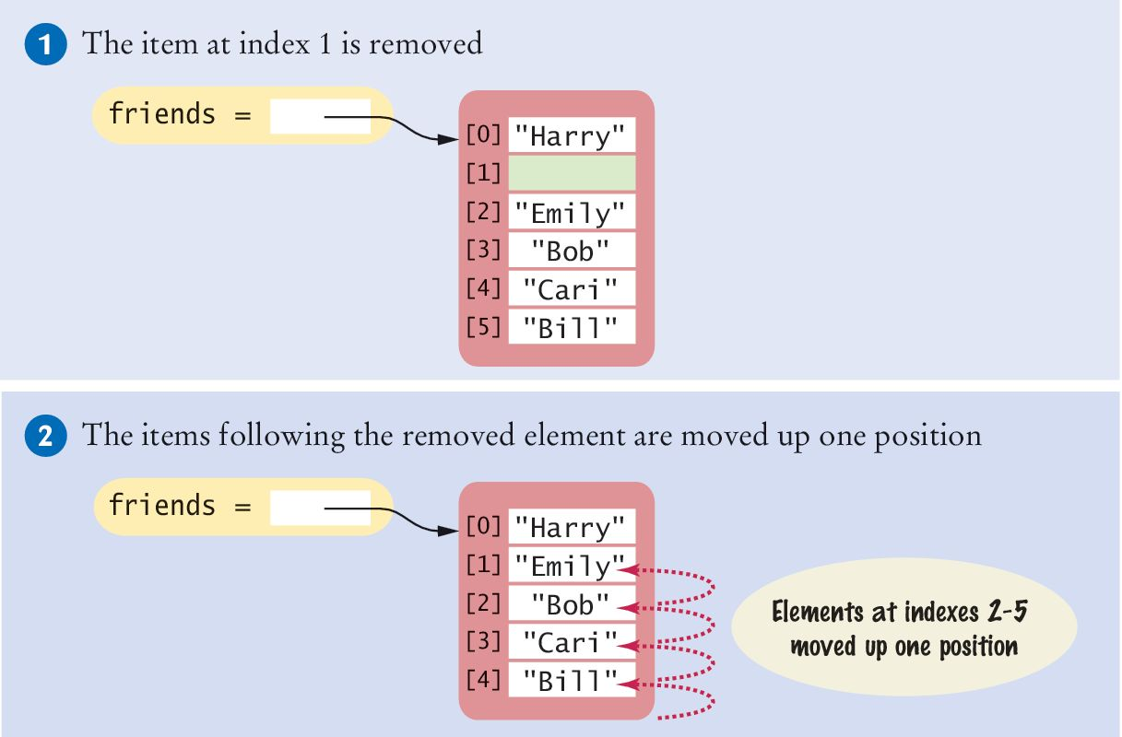
Popping an Element (1)
The pop() method removes the element at a given position
friends = ["Harry", "Cindy", "Emily", "Bob", "Cari","Bill"]
friends.pop(1)
All of the elements following the removed element are moved up one position to close the gap.
The length of the list is reduced by one.

Slide 33
Popping an Element (2)
When there is no input argument, the pop() method removes the last element in the list.
friends = ["Harry","Emily","Bob","Cari","Bill"]
person = friends.pop() # 'Bill' is returned
print(friends) # output: ['Harry','Emily','Bob','Cari']
print(person) # output: 'Bill'

Slide 34
Removing an Element
The remove() method removes the first element that matches the input argument.
friends = ["Harry","Emily","Bob","Cari","Bill"]
friends.remove("Emily")
print(friends) # output: ['Harry','Bob','Cari','Bill']
If there is no matching element in the list, remove() raises an exception during run time.

Slide 35
Sort a List
The sort() method sorts a list of numbers or strings.
The default sort is in ascending order.
To sort in descending order, use the reverse keyword argument:
values = [1, 16, 9, 4]
values.sort() # Now values is [1, 4, 9, 16]
values = [1, 16, 9, 4]
values.sort(reverse=True)
# Now values is [16, 9, 4, 1]

Slide 36
Reverse, Count in a List
The reverse() method reverses a list:
The count() method returns the count of matched elements
values = [1, 16, 9, 4]
values.reverse() # Now values is [4, 9, 16, 1]
names = ['Python', 'Perl', 'C', 'C++', 'Java', 'C']
print(names.count('C')) # output: 2
print(names.count('Python')) # output: 1

Slide 37
Copy a List
The copy() method copies a list to another list by copying all the elements into the new list.
L1 = [1, 4, 9]
L2 = L1.copy()
L1 == L2 # True
L1 is L2 # False

Slide 38
Common List Algorithms

Slide 39
Filling a List
Filling a list means adding multiple data values into a list.
This loop creates and fills a list with squares (0, 1, 4, 9, 16, ...)
There is a faster way: using list comprehension
values = [] # create an empty list
for i in range(n) :
values.append(i * i) # add n data to the list

Slide 40
Element Separators
When displaying the elements of a list, we usually want to separate them with a separator, such as a comma: Harry, Emily, Bob
Add the separator before each element in the sequence except the initial one (with index 0):
To print directly without creating a result string:
for i in range(len(names)) :
if i > 0 :
result = result + ", "
result = result + names[i]
print(result)
for i in range(len(values)) :
if i > 0 :
print(", ", end="")
print(values[i], end="")
print()

Slide 41
Collecting and Counting Matches
Collecting all matches
limit = 100
result = []
for element in values :
if (element > limit) :
result.append(element)
Counting matches
limit = 100
counter = 0
for element in values :
if (element > limit) :
counter = counter + 1
There is a faster way: using list comprehension

Slide 42
Removing Matches
Remove all elements that match a particular condition
Example: remove all strings of length < 4 from a list
i = 0
while i < len(words) :
word = words[i]
if len(word) < 4 :
words.pop(i)
else :
i = i + 1

Slide 43
Reading Input
It is very common to read input from a user and store it in a list for later processing.
values = [] # create empty list
print("Please enter values, Q to quit:")
userInput = input("") # initialize
while userInput.upper() != "Q" : # test
values.append(float(userInput))
userInput = input("") # update
Please enter values, Q to quit:
32
29
67.5
Q
Program execution

Slide 44
Using Lists With Functions

Slide 45
Using Lists With Functions
A function can accept a list as an argument
The following function visits the elements of the list called values, but it does not modify them
But since a function accepts the alias of a list as input argument, it can change the data in the list.
The following function multiplies all elements of a list by a given factor:
def printList(values) :
for element in values :
print(element)
def multiply(values, factor) :
for i in range(len(values)) :
values[i] = values[i] * factor

Slide 46
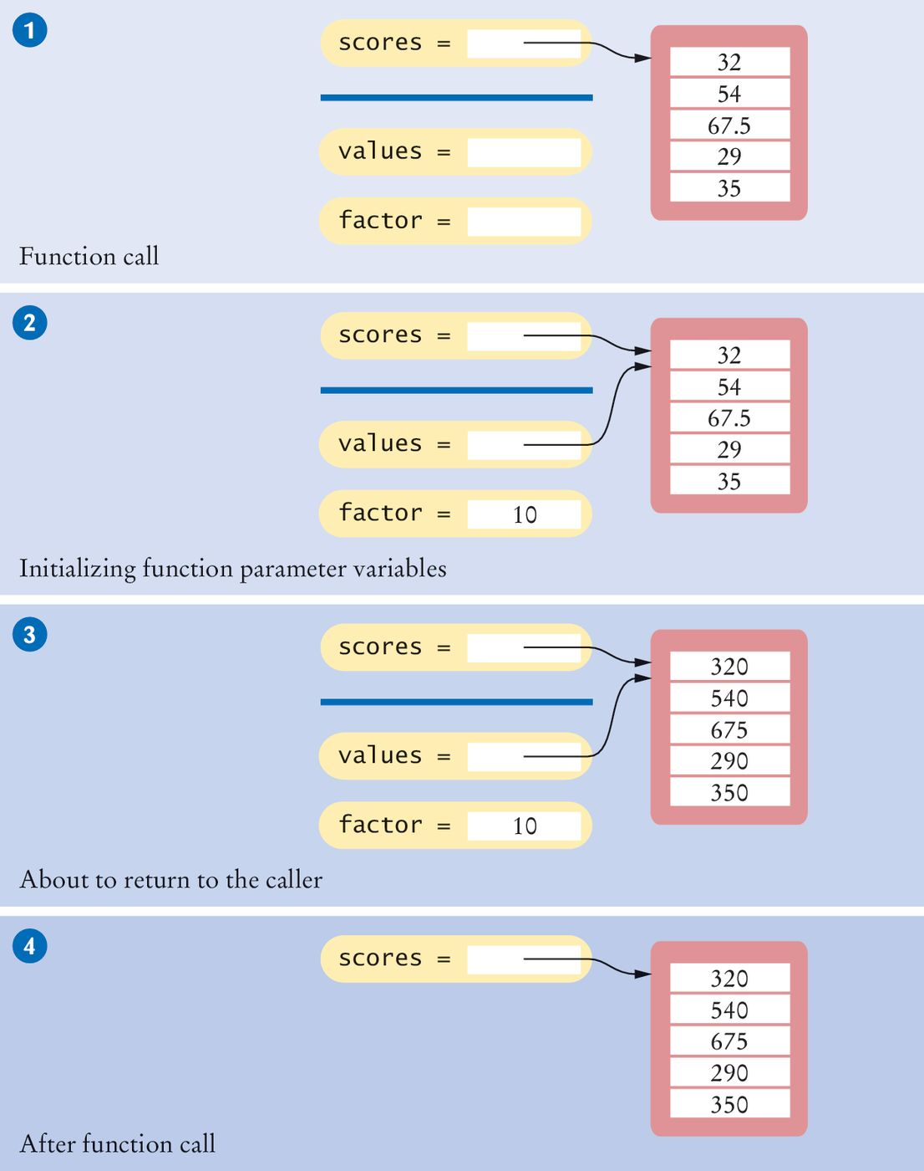
Example: Step 1
The parameter variables values and factor are created

Slide 47
Example: Step 2
The parameter variables are initialized with the arguments that are passed in the call
In our case, values is set to scores and factor is set to 10
Note that values and scores are references to the same list
# Function call
multiply(scores, 10)

Slide 48
Example: Step 3
The function multiplies all list elements by 10
def multiply(values, factor) :
for i in range(len(values)) :
values[i] = values[i] * factor

Slide 49
Example: Step 4
The function returns. Its parameter variables are removed
However, scores still refers to the list with the modified elements

Slide 50
Returning Lists From Functions
If a function creates a list then it can return the list name as a return value.
The return value (the list name) is a reference to the list.
In this example, the squares() function returns a list of squares from 0² up to (n – 1)²:
def squares(n) :
result = []
for i in range(n) :
result.append(i * i)
return result

Slide 51
Tuples

Slide 52
Basic Properties of Tuples

Slide 53
Tuples (1)
A tuple is similar to a list, but once created, its contents cannot be modified. A tuple is an immutable version of a list.
A tuple is created by specifying its contents as a comma-separated sequence. A tuple is typically enclosed in parentheses:
triple = (5, 10, 15)
We can omit the parentheses, but this is less readable:
triple = 5, 10, 15
To create an empty tuple:
emptyTuple = ()

Slide 54
Tuples (2)
To create a tuple we need to have at least one comma to separate the elements. Therefore, to create a tuple with one value, the comma is still require:
smallTuple = (5,)
Any sequence of multiple values that are comma-separated, written without identifying symbols, i.e., brackets for lists, parentheses for tuples, etc., will default to tuples:
>>> x = "abc", 2, 8.5, "xyz"
>>> x
('abc', 2, 8.5, 'xyz')
>>> type(x)
<class 'tuple'>

Slide 55
Operators for Tuples
To access data in a tuple, use [ ] and an index (positive or negative), just like with a list.
A slice can be used to access multiple data values in a tuple.
Tuples work with all the sequencing operators in list:
tup1 + tup2 returns the concatenation of the 2 tuples
myTuple * 3 returns a copy of myTuple replicated 3 times
“abc” in myTuple returns True if “abc” is in myTuple, False otherwise
for elem in myTuple: iterates through each element of the tuple

Slide 56
Functions and Methods For Tuples
Functions
sum() to find the sum of elements: sum(tup1, tup2)
len() to find the number of elements: len(tup1)
max() to find the max element: max(tup1)
min() to find the min element: min(tup1)
tuple() to convert any iterable to a tuple: tuple(iterable)
Method
count() to find the count of a data value: myTuple.count(data)

Slide 57
Working with Tuples

Slide 58
Returning Multiple Values
It is common practice in Python to use tuples to return multiple values.
# Function definition
def readDate() :
month = int(input("Month: "))
day = int(input("Day: "))
year = int(input("Year: "))
return (month, day, year) # Return a tuple
# Function call: assign entire value to a tuple
date = readDate() # date is a tuple
# Function call: use tuple assignment
(month, day, year) = readDate() # month, day, year
# are individual variables

Slide 59
Swapping Data
Tuples are also useful when swapping data values
No need for a temp variable like in many other languages.
num1 = 5
num2 = 8
num3 = 4
(num1, num2) = (num2, num1)
# num1 is now 8, num2 is now 5
num1, num2, num3 = num2, num3, num1 # not using ()
num1 is now 5, num2 is 4, num3 is 8

Slide 60
Tuples vs Lists
Similarities:
Container to store a sequence of data of any type.
Data are in a specific order and can be accessed by index values and by iterating through all data.
Differences:
Lists are mutable: data values can be changed, added to and removed from a list.
Tuples are immutable: data cannot be changed, added, or removed.
Because of the immutability restrictions, tuples are more memory efficient and faster to store and access data than lists.
Generally lists are used when we need to change the data or don’t know what the size of the list will be. Tuples are used when we know the number of data values that need to be stored and the data should not be changed.

Slide 61
Named Tuples
A named tuple is a special type of tuple that gives us the ability to refer to elements by names in addition to by index position.
A named tuple is a data type that’s part of the collections module, which we need to import.
Then we defined our named tuple and assign it a name:
where “field names” is a string of space delimited names of data fields
Now we can create as many named tuples of the type myNamedTuple as we need.
The field names, not index values, are used to access the element of the named tuple. This makes the code more readable because the field name is more descriptive than an index number.
myNamedTuple = collections.namedtuple(“myNamedTuple”, “field names”)

Slide 62
Named Tuple Example
We want to create a tuple for the (x,y,z) coordinate of a point and then printing the x coordinate.
Using a regular tuple:
Using a named tuple:
pointA = (1, 0, -1) # pointA is a tuple
print(“x coordinate:”, pointA[0]) # the x coordinate is at index 0
import collections
# define the named tuple called “point”
point = collections.namedtuple(“point”, “x y z”)
pointB = point(1, 0, -1) # PointB is a named tuple print(“x coordinate:”, pointB.x) # It’s more obvious that we # access the x coordinate

Slide 63
Tables or List of Lists

Slide 64
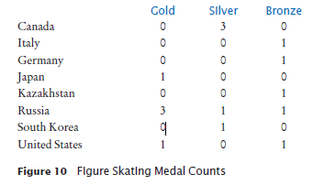
Tables
Lists can be used to store data in two dimensions (2D) like a table or spreadsheet or matrix.
A table has rows and columns.

Slide 65
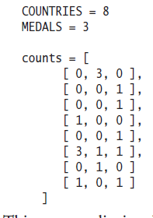
Creating Tables (1)
Here is the code for creating a table that contains 8 rows and 3 columns, which is suitable for holding our medal count data:
The table named counts is an outer list which contains 8 inner lists. This is why a table is called a list of lists.

Slide 66
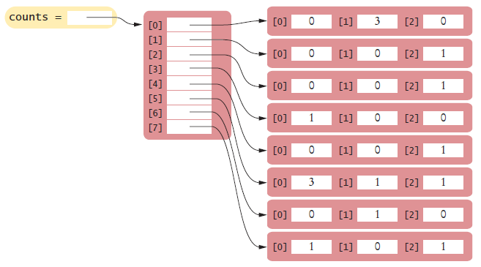
Creating Tables (2)
In memory the table is a list of 8 lists:

Slide 67
Creating and Initializing Tables
First, create a list that will be used to store the references to the individual rows:
table = []
Then, in a loop, create each inner list using replication (with the number of columns as the size) for each row in the table and append it to the list of rows:
ROWS = 5
COLUMNS = 20
for i in range(ROWS) :
row = [0]*COLUMNS
table.append(row)
Or, shorter:
The result is a table that consists of 5 rows and 20 columns
table = [ [0]*COLUMNS for i in range(ROWS) ]

Slide 68
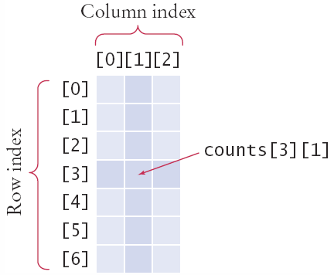
Accessing Elements
Use two index values:
[row][column]
medalCount = counts[3][1]
To print
Use nested for loops
Outer row(i) , inner column(j)
for i in range(COUNTRIES):
for j in range(MEDALS) :
# Process the jth column in the ith row
print("{:8d}".format(counts[i][j]), end="")
print() # Start a new line at the end of the row

Slide 69
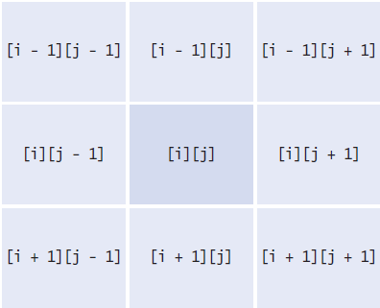
Locating Neighboring Elements
Some programs that work with two-dimensional lists need to locate the elements that are adjacent to an element
This task is particularly common in games
If the we are at loc i, j then the table shows the index for the adjacent elements.
Watch out for edges!
Do not go off the table

Slide 70
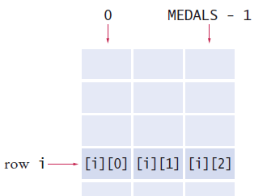
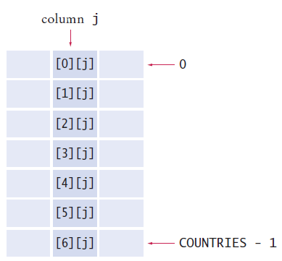
Traversing Rows and Columns
Going across a row i
Going down a column j
total = 0
for j in range(MEDALS):
total = total + counts[i][j]
total = 0
for i in range(COUNTRIES):
total = total + counts[i][j]

Slide 71
Copying Tables
Just like with lists, when we need to copy a table, we cannot simply assign the table name to another variable. This only creates an alias to the existing table.
To copy a table, which means copy all the inner lists as well as the outer list, Python provides a deepcopy function in the copy module.
import copy
table2 = copy.deepcopy(table1)

Slide 72
Advanced Topics with Lists

Slide 73
List Comprehension
A list comprehension creates a list out of an existing sequence of data.
It iterates through the existing sequence of data and filters out some of the elements, does work with each of these elements, and stores each result into the new list.
The existing sequence of data is not modified.
Here is what a list comprehension looks like in the format of a for loop:
Here is the actual list comprehension:
newList = []
for elem in existingSeq:
if condition_with_elem: # filter out certain elements
newList.append( do_work_with_elem ) # transform the elem # and store in newList
newList = [ do_work_with_elem for elem in existingSeq if condition_with_elem ]

Slide 74
Examples (1)
myList contains negative and positive integers.
We want to create a new list of the absolute value of all the negative values in myList.
Loop format:
List comprehension:
newList = []
for elem in myList:
if elem < 0:
newList.append( abs(elem) )
newList = [ abs(elem) for elem in myList if elem < 0 ]

Slide 75
Examples (2)
celsius is a tuple containing temperatures in degrees celsius.
We want to create a new list fahrenheit of the same temperatures in degrees fahrenheit.
In this case we convert all elements of the tuples, there is no filtering out of data.
Loop format:
List comprehension:
fahrenheit = []
for temp in myList:
fahrenheit.append( temp * 9/5 + 32 )
fahrenheit = [ temp * 9/5 + 32 for temp in celsius ]

Slide 76
When to Use List Comprehension
List comprehension can be used when we need to loop through a sequence of data and append a subset of this data (modified or not) to a new list.
List comprehension results in more efficient code than the “loop and append” method. List comprehension should always be considered when creating a new list out of an existing list.
However, readability is important. If the list comprehension takes several wrapped around lines of code, then a loop might be a better choice, if time is not critical.
Also, list comprehension should be used only when we need to create a new list. It is not meant to replace all iteration loops. If we need to print all elements of a list for example, a loop makes more sense.

Slide 77
End of Chapter 6 Notes

